Slide 1







2019 STACK OVERFLOW DEVELOPER SURVEY
Yuvarekha Mahendran
January 12,2024

Slide 2



OUTLINE
Executive Summary
Introduction
Methodology
Results
Visualization – Charts
Dashboard
Discussion
Findings & Implications
Conclusion
Appendix

Slide 3

EXECUTIVE SUMMARY
Data analysing goal
Description
Gathering data
Analysis of data
Visualization of data
Results shown with the help of dashboard outputs as graphs
Overall findings and implications with respect to the results shown in graph
Overall conclusion

Slide 4

INTRODUCTION
Stack overflow’s annual developer survey 2019 is the most comprehensive survey of people who code globally
Currently,there are 90000 developers according to May 2023 data
Data keeps changing every year as programming languages evolve
Data is analysed by two ways
Technology trends
Demographics

Slide 5

METHODOLOGY
Data collection and glance through the dataset
1)Scraping data from web
2) API
3)Importing requests library
Data wrangling
Exploratory data analysis
1)Data analysis with data distribution
2)Outlier detection
3)Correlation of data
Data visualization
Output

Slide 6

RESULTS

Slide 7
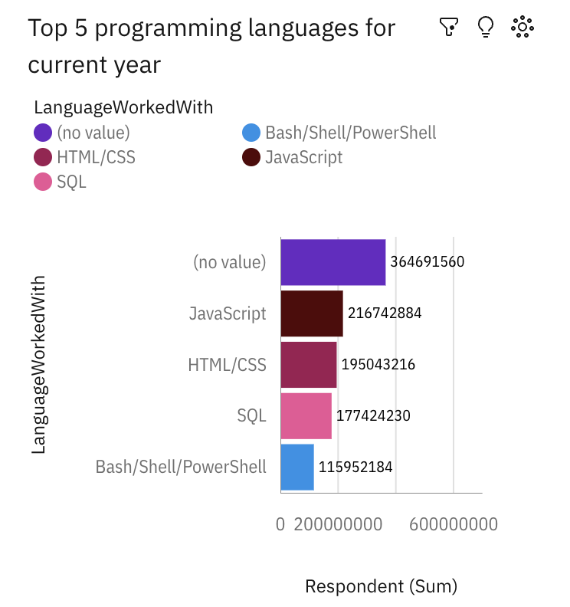
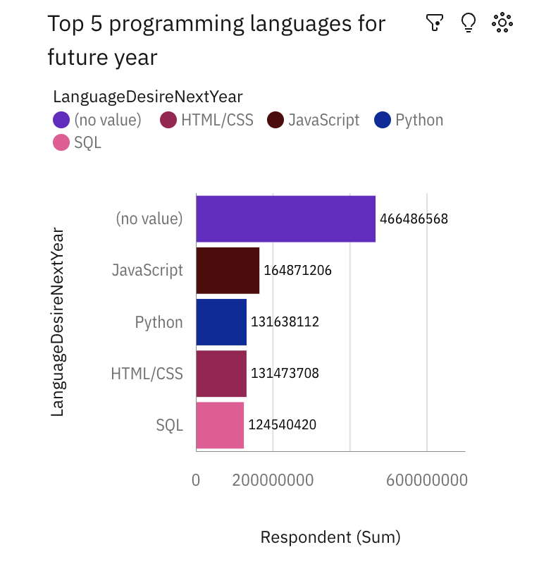
PROGRAMMING LANGUAGE TRENDS
Current Year
Next Year

Slide 8
PROGRAMMING LANGUAGE TRENDS - FINDINGS & IMPLICATIONS
Findings
Javascript tends to be second fastest growing language
People’s interest in scripting languages keeps increasing in current year
Future trends displays python as one of the growing languages
Implications
Shift in first fastest growing language in future trends
Fond for python programming by future developers

Slide 9
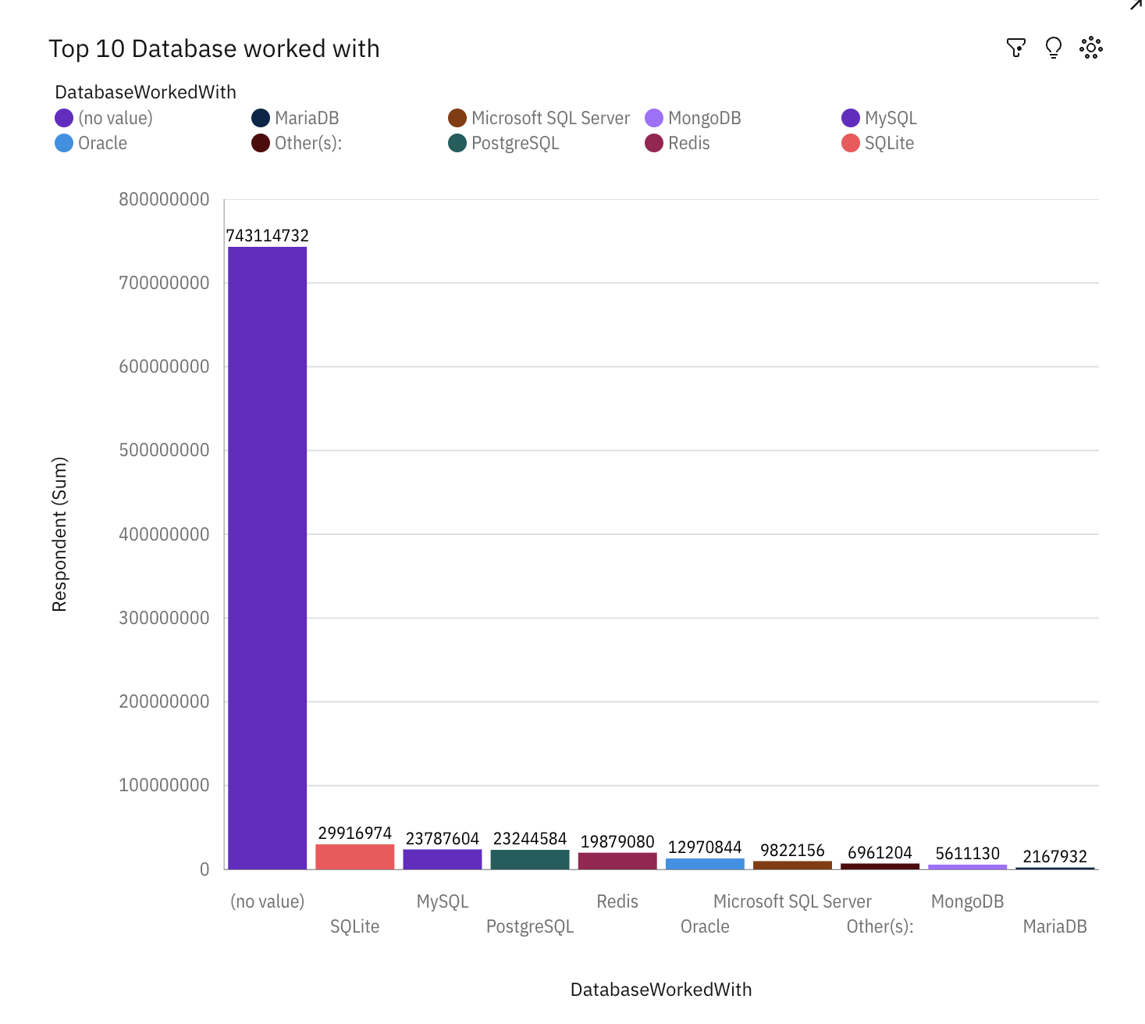
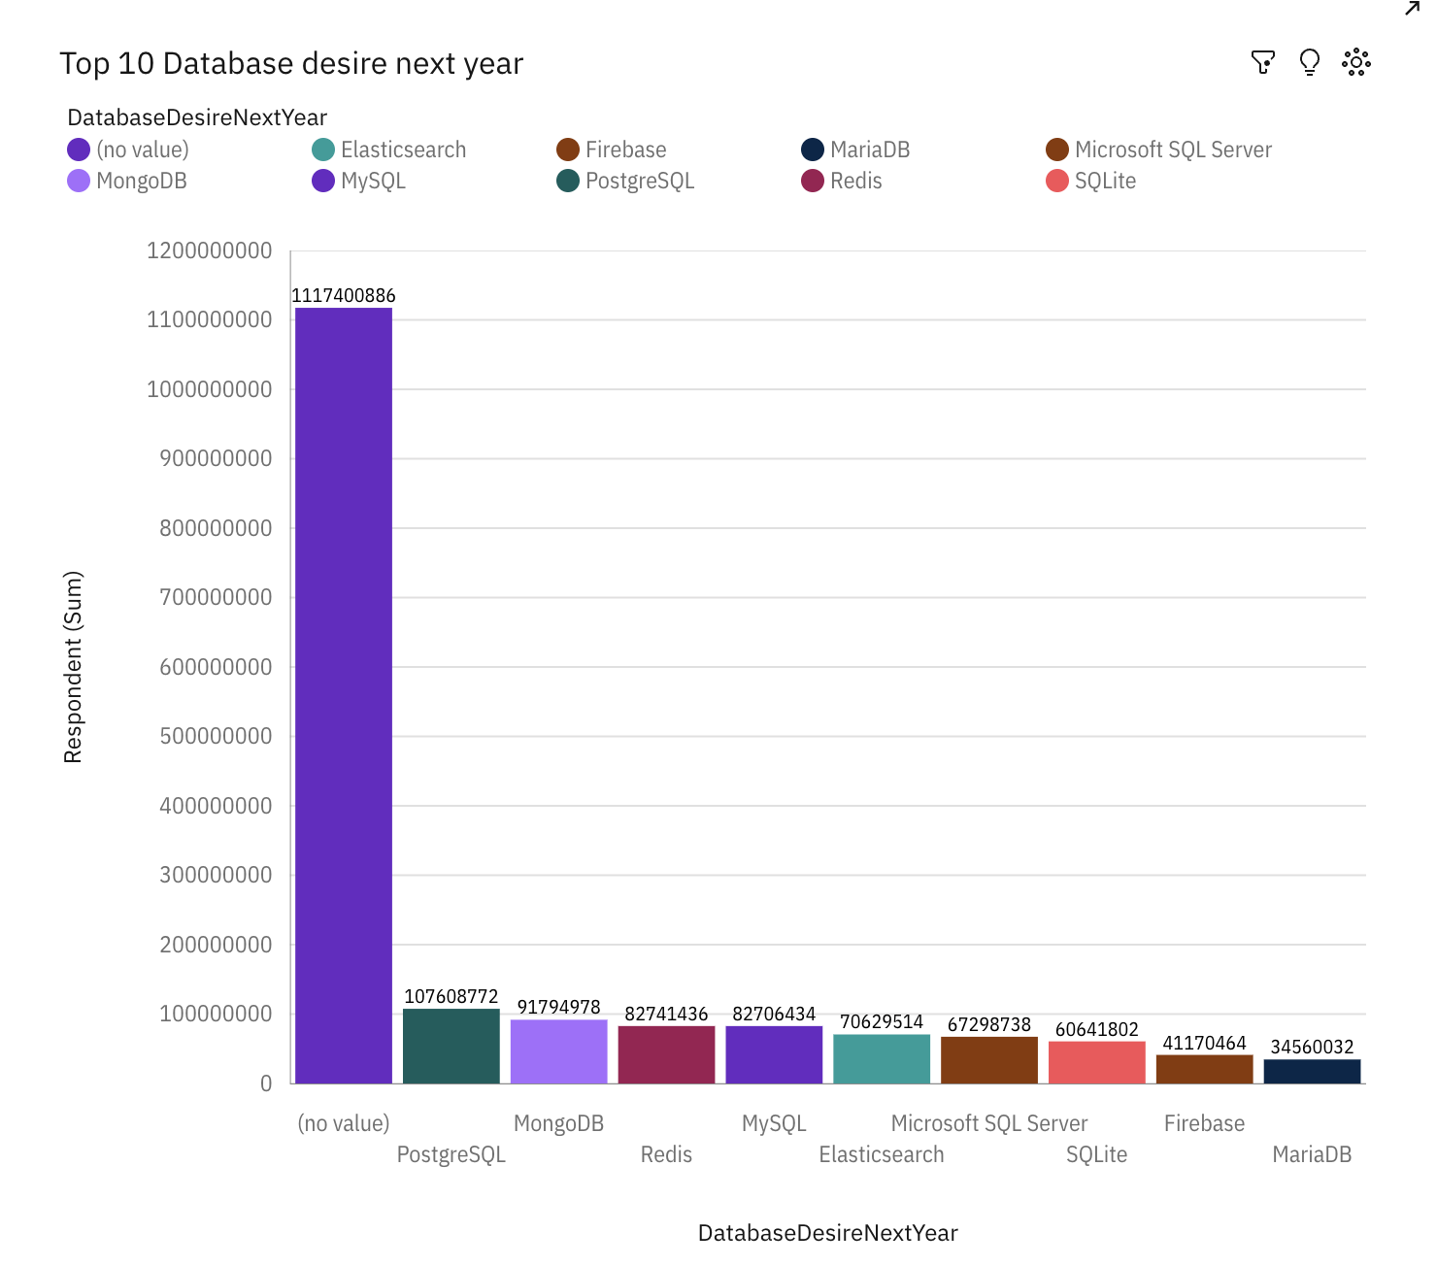
DATABASE TRENDS
Current Year
Next Year

Slide 10
DATABASE TRENDS - FINDINGS & IMPLICATIONS
Findings
SQLite becomes the fastest evolving language
Increased interest in MongoDB,MariaDB in future trends compared to current trends
New interest in Firebase in future findings.
Implications
Introduction to Firebase in evolving market
Shift in interest towards MongoDB and MariaDB

Slide 11
DASHBOARD
https://us3.ca.analytics.ibm.com/bi/?perspective=dashboard&pathRef=.my_folders%2FCapstone&action=view&mode=dashboard&subView=model0000018cfb7900bc_00000000

Slide 12
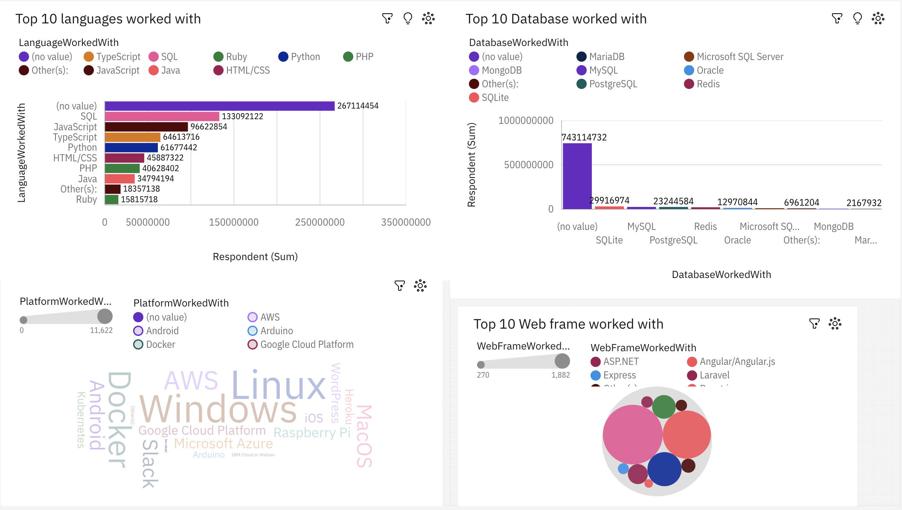
DASHBOARD TAB 1

Slide 13
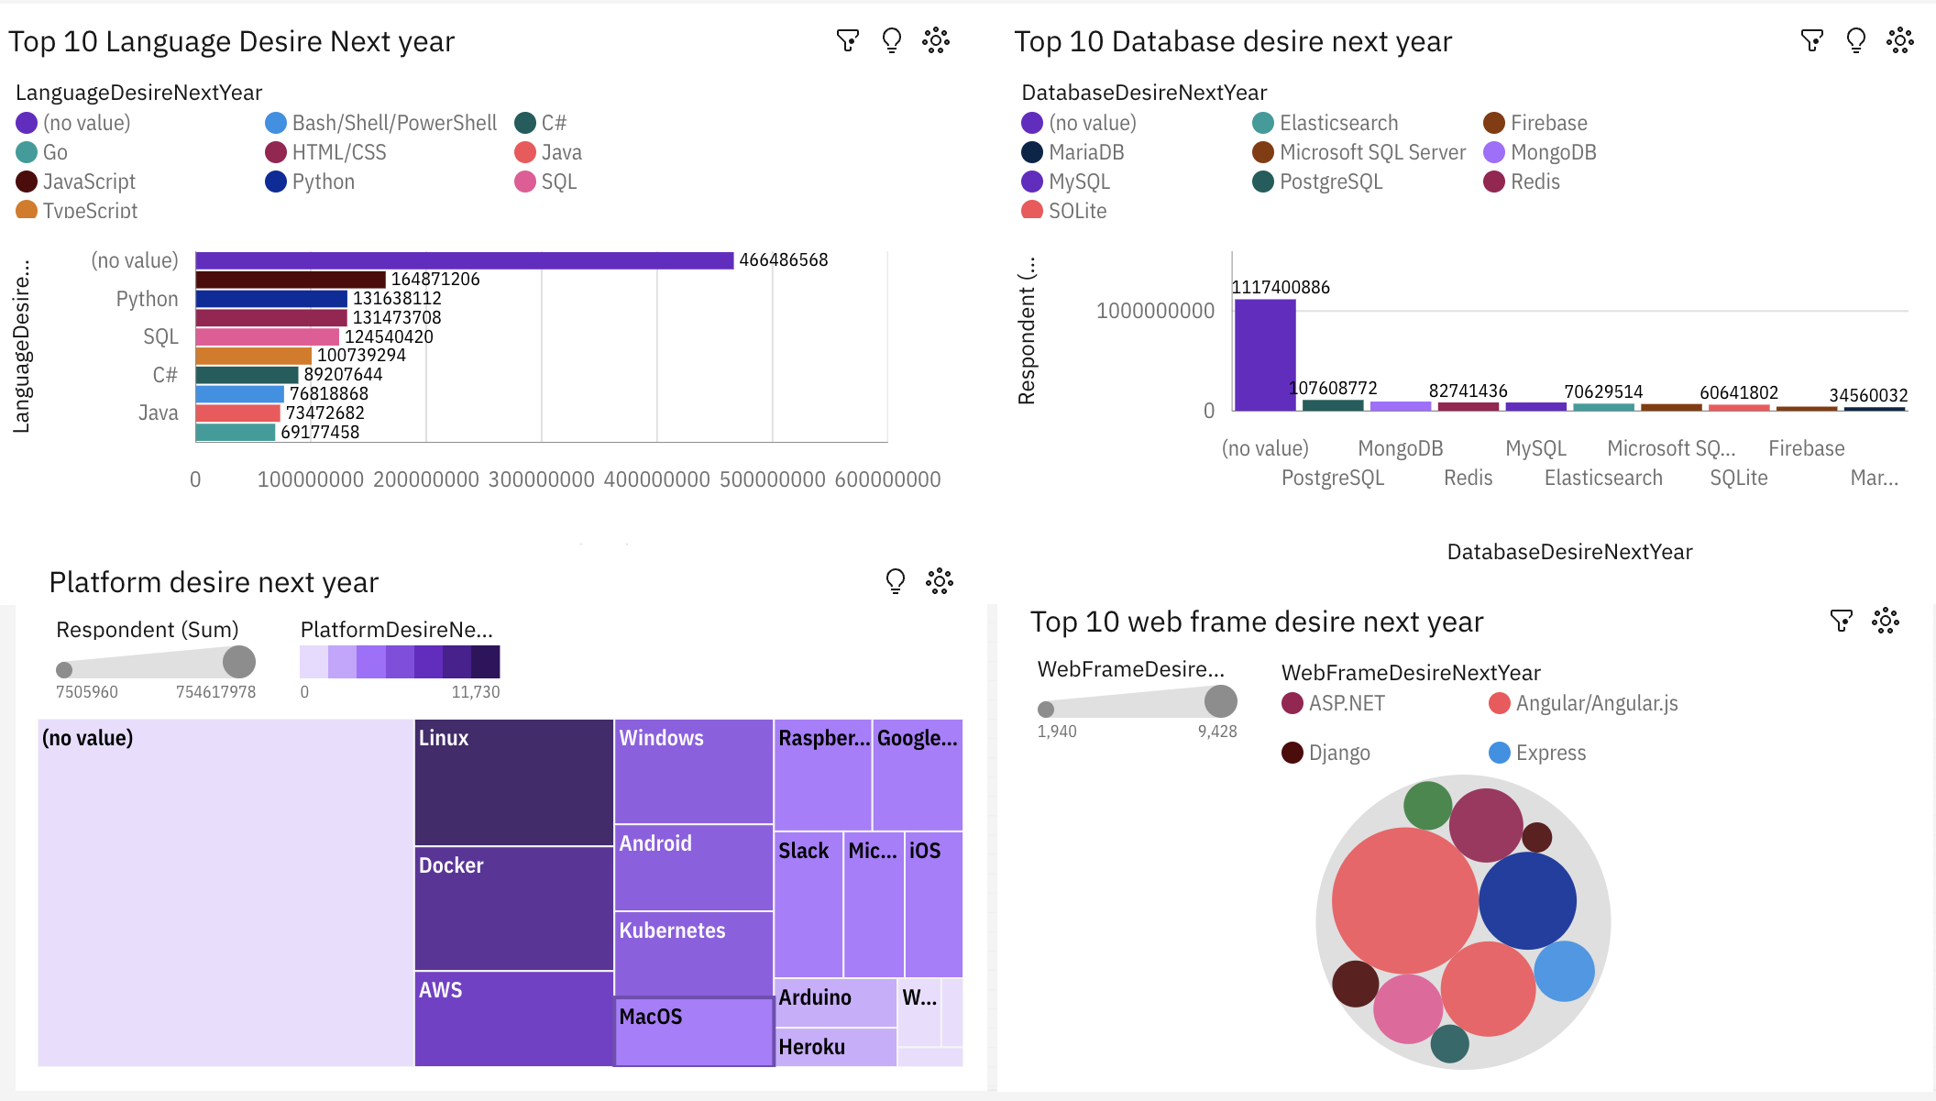
DASHBOARD TAB 2

Slide 14
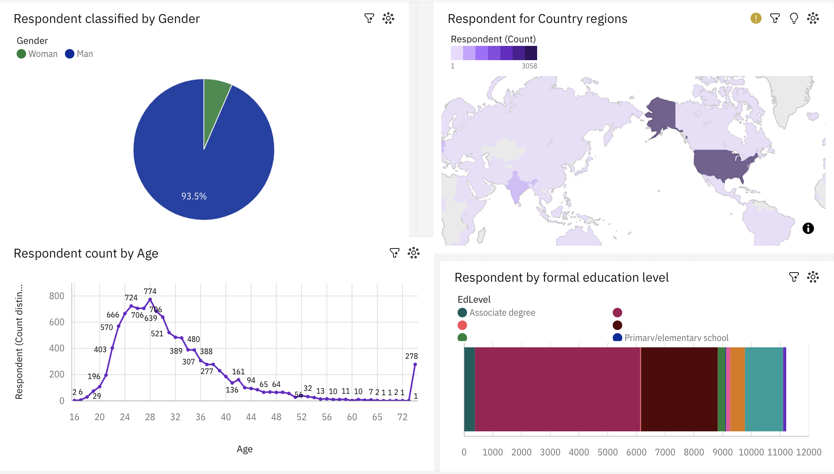
DASHBOARD TAB 3

Slide 15
DISCUSSION
Increased interest towards database in future years
Growth in technological sectors
The increasing demand in database software like MongoDB,MariaDB in future years
What about Swift and GoLang programming languages?

Slide 16
OVERALL FINDINGS & IMPLICATIONS
Findings
Minimum qualification of all developers is BE in CSE
Increased interest towards database softwares
Python is fastest growing programming language
Implications
Data professionals must be proficient in SQL,tableau and Excel with python
Increased concentration in basic foundational topics in python
Professional growth globally is essential

Slide 17

CONCLUSION
It is important for data professionals to be proficient in both scripting and programming languages for a successful career in upcoming technology improvements
Importance to database is also equally important
Data visualizations like Tableau should also be very helpful tool to view as dashboards
Data professionals should be expert in calculations with Excel spreadsheet

Slide 18

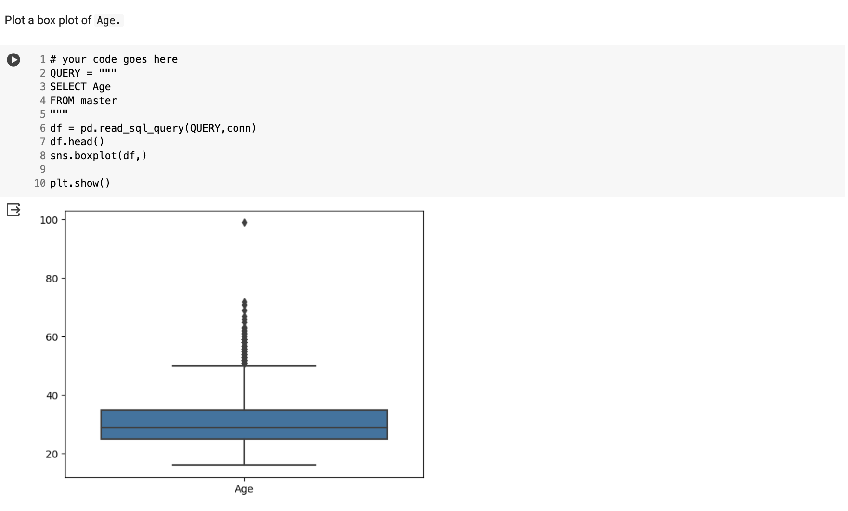
APPENDIX

Slide 19
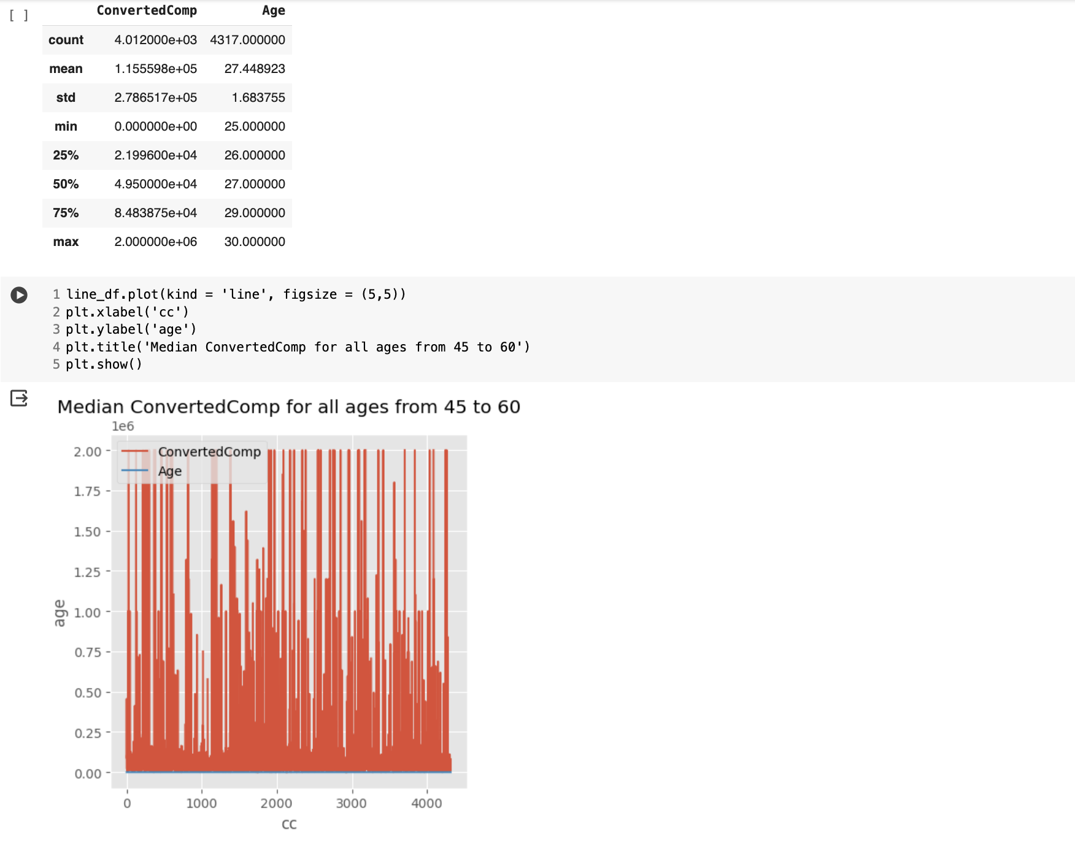
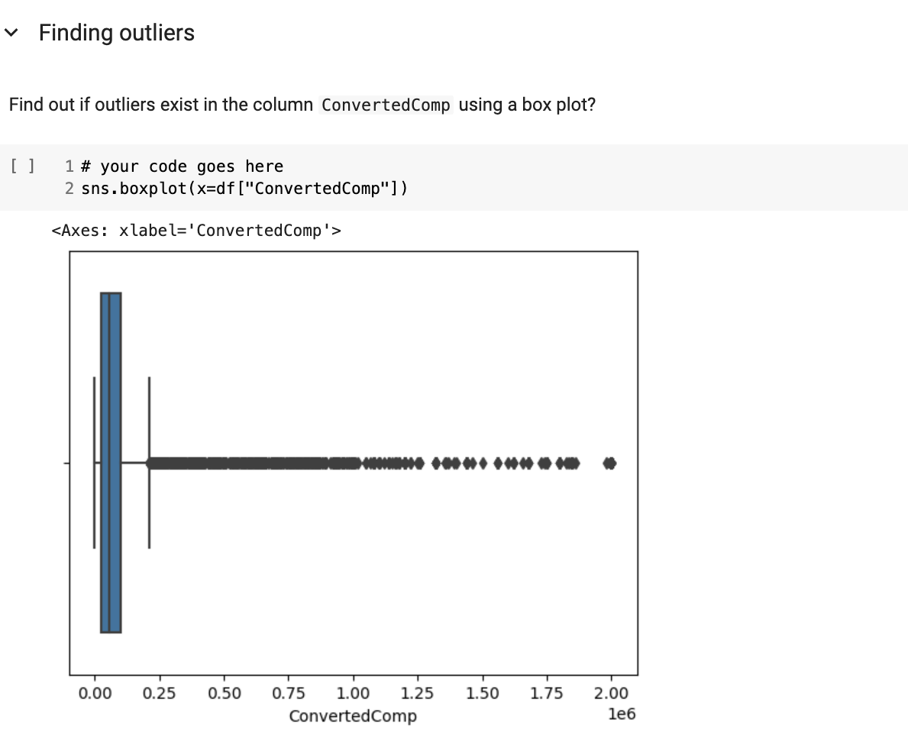

Slide 20
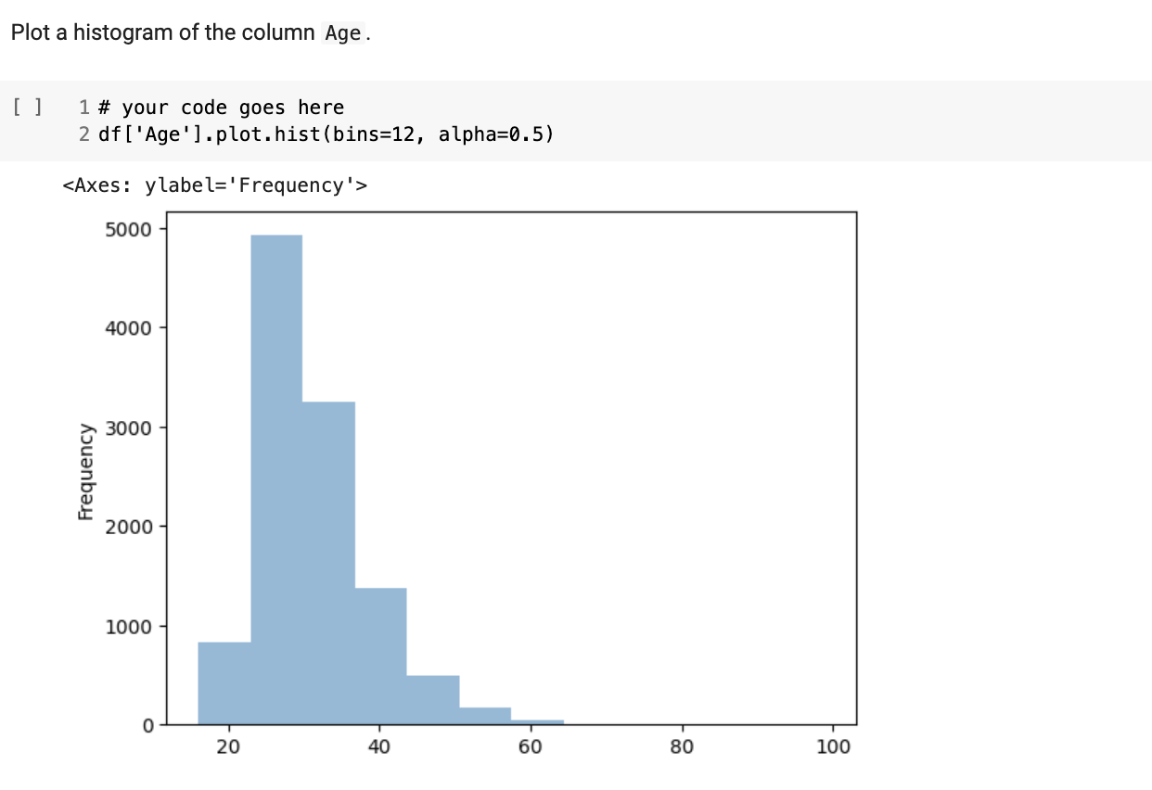
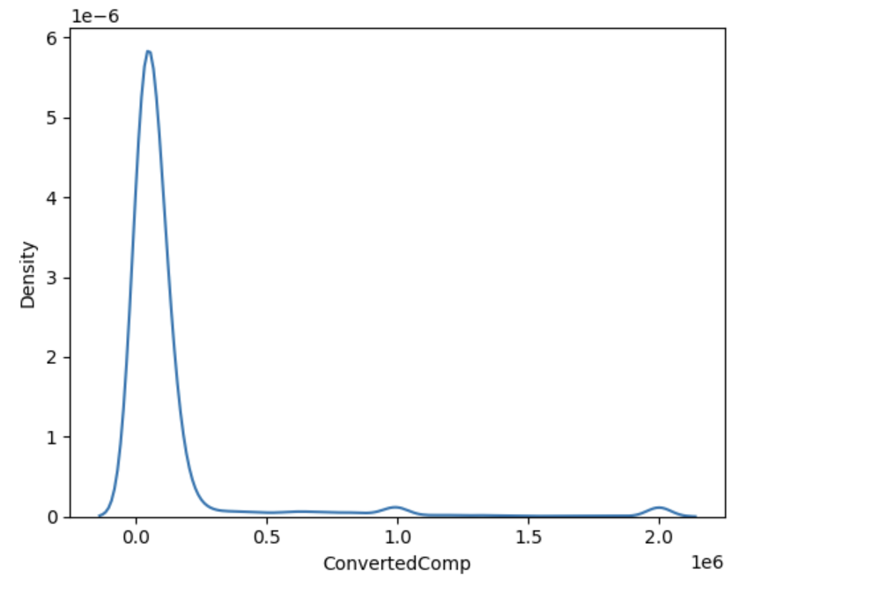

Slide 21
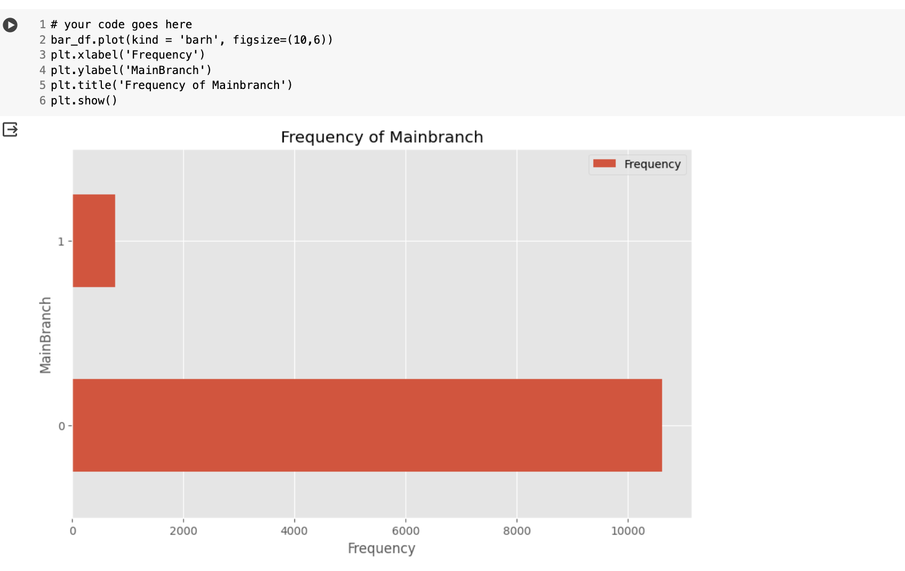

Slide 22
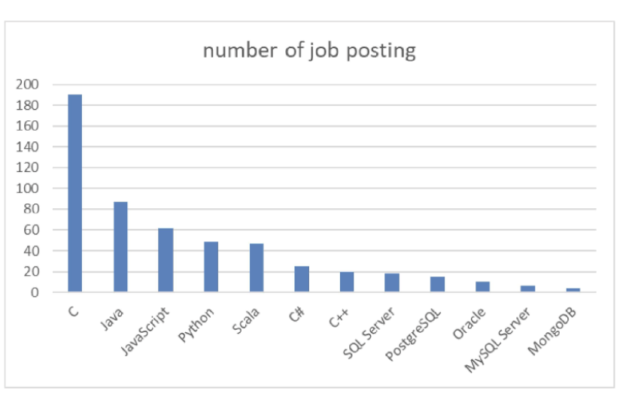
JOB POSTINGS

Slide 23
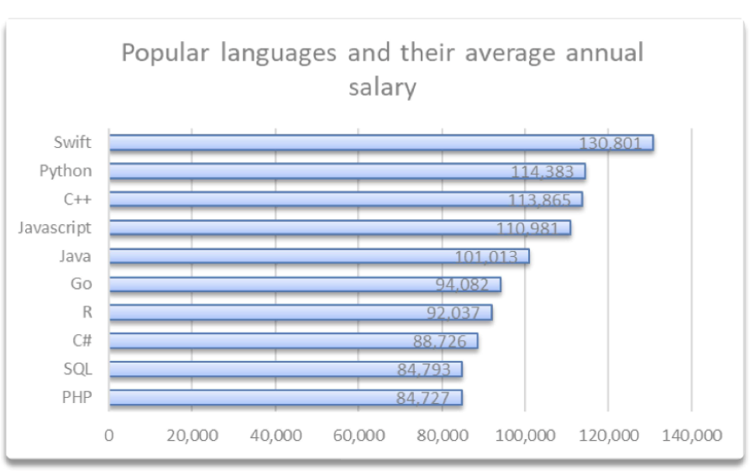
POPULAR LANGUAGES

